Slide 1


R - Eliminating Fear, Uncertainty and Doubt
Mike K Smith, Pfizer
Global
Pharmacometrics

Slide 2
Disclaimer
This talk represents the opinions of the speaker and are not necessarily shared by others at Pfizer Ltd., and specifically, do not necessarily represent Pfizer Quality, IT, Statistics, or Legal department opinions.

Slide 3
Acknowledgements
Ian Francis
Frank Harrell Jr.
Max Kuhn
Rich Pugh
Anthony Rossini
Marc Schwartz
David Smith
Mat Soukup

Slide 4
Fear, Uncertainty, Doubt

Slide 5
Fear, Uncertainty, Doubt
… a sales or marketing strategy of disseminating negative (and vague) information on a competitor's product. (Wikipedia)

Slide 6


WHICH IS BETTER?
VS
…LET’S NOT GO THERE

Slide 7
Let’s play
“True” or “False"

Slide 8
True or False?
Regulatory agencies will only accept statistical analysis and reports prepared using validated systems such as SAS and S-Plus.

Slide 9
TRUE…
Regulatory agencies will only accept statistical analysis and reports prepared using validated systems such as SAS and S-Plus.

Slide 10
…FALSE
“The Food and Drug Administration does not endorse or require use of any specific software…”
- Mat Soukup, FDA (UseR Conference 2007)

Slide 11
FDA Expectations
2002 General Principles of Software Validation - Final
2003 Guidance Part 11: Electronic Records - Final
2007 Guidance on Computerized Systems Used in Clinical Investigations - Final
Summary of key points applied to clinical trials presented by:
Bell et al., JSM, 2006

Slide 12
True or False?
Open-source software such as R cannot be validated therefore is not acceptable.

Slide 13
True or False?
Open-source software such as R cannot be validated therefore is not acceptable.
???

Slide 14
What do we mean by “Validation”?
“Establishing documented evidence which provides a high degree of assurance that a specific process will consistently produce a product meeting its predetermined specifications and quality attributes.” – FDA definition.

Slide 15
What do we mean by “Validation”?
“Establishing documented evidence which provides a high degree of assurance that a specific process will consistently produce a product meeting its predetermined specifications and quality attributes.” – FDA definition.

Slide 16
What do we mean by “Validation”?
“Establishing documented evidence which provides a high degree of assurance that a specific process will consistently produce a product meeting its predetermined specifications and quality attributes.” – FDA definition.

Slide 17
What do we mean by “Validation”?
“Establishing documented evidence which provides a high degree of assurance that a specific process will consistently produce a product meeting its predetermined specifications and quality attributes.” – FDA definition.

Slide 18
What do we mean by “Validation”?
“Establishing documented evidence which provides a high degree of assurance that a specific process will consistently produce a product meeting its predetermined specifications and quality attributes.” – FDA definition.

Slide 19
Validation
≠
21 CFR part 11 compliance

Slide 20
21 CFR part 11
21 CFR Part 11 was issued by the FDA to provide regulatory requirements for processes and controls that must be applied to electronic records and electronic signatures.
i.e. output from validated systems.

Slide 21
21 CFR part 11
The guidance can be summarized as follows:
If there are predicate rules that require records to be maintained, and these records are managed electronically, then Part 11 controls apply to those records.
If there are predicate rules that require a signature to be applied, and this signature is applied electronically or digitally, then Part 11 controls apply.

Slide 22
21 CFR part 11
“Records submitted to FDA, under predicate rules in electronic format [are Part 11 records]. However, a record that is not itself submitted, but is used in generating a submission, is not a part 11 record unless it is otherwise required to be maintained under a predicate rule and it is maintained in electronic format."

Slide 23
Good Practice
Installation qualification (IQ)
Is the software installed and maintained according to Software Development Life Cycle (SDLC) processes / SOPs?
Operation qualification (OQ)
Is the software consistent / stable?
Performance qualification (PQ)
Is the software producing results that are credible, reproducible and meeting agreed standards?
And all of this documented…

Slide 24
Good practice leads to
Validation

Slide 25
What was the question?
Open-source software such as R cannot be validated therefore is not acceptable.

Slide 26
SO… FALSE
YOUR SOPs and practice governing IQ/OQ/PQ will help dictate whether YOUR use of R falls within GxP.
21 CFR Part 11 doesn’t necessarily apply to software systems per se but their output.
(See R-FDA document for more details).

Slide 27
True or False?
Since R has been developed by academics and non-commercial organisations who have no stake in the correctness or otherwise of their code, we cannot rely on results being correct.

Slide 28
TRUE… BUT…
Commercial products have their faults too.
Remember Microsoft Excel’s Standard Errors?
Is SAS entirely bug-free? Viz: SAS Hot Fixes.

Slide 29
Example: nlme
nlme function is in S-Plus for analysis using nonlinear mixed effects models, written by Doug Bates, Jose Pinheiro…
…The same function appears in R.

Slide 30
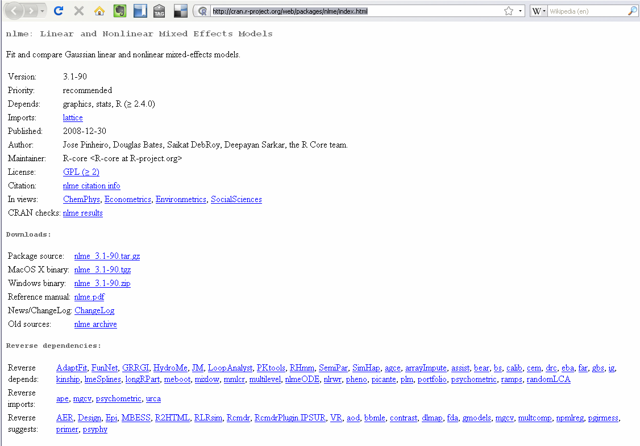
CRAN = Comprehensive R Archive Network

Slide 31
True or False?
R functions could easily be edited by any user to change their algorithms and so cannot be validated.

Slide 32
TRUE…
Users CAN alter functions to “mask” those from standard packages.
- You DO get a warning however.

Slide 33
…AND FALSE
Validation argument though comes back to GxP and reproducibility.
- If YOUR functions follow SDLC and are reproducible then their use can be “validated”.

Slide 34
True or False?
Any work performed in R must be validated by replication using other "approved" software before submission.

Slide 35
True or False?
Any work performed in R must be validated by replication using other "approved" software before submission.
!!!

Slide 36
FALSE
IF you have followed GxP, SDLC, IQ/OQ/PQ processes, SOPs etc. for R installation and use…
THEN there should be no need to reproduce work.

Slide 37
REMEMBER
“The Food and Drug Administration does not endorse or require use of any specific software…”
- Mat Soukup, FDA (UseR Conference 2007)

Slide 38
ASIDE…
SAS have released experimental procedures for Bayesian analysis and PROC MCMC.
Do we use PROC MCMC or WinBUGS / OpenBUGS as the benchmark?

Slide 39
True or False?
R has never been used for business critical work at the FDA.

Slide 40
FALSE
Statistical review (meta-analysis) of Avandia (rosiglitazone) at FDA Advisory Committee by Joy Mele.

Slide 41
R at the FDA
Mat Soukup reports in his presentation that there is a growing number of statisticians at FDA who use R.
- R software is “approved” for use by FDA IT organisation.

Slide 42
R used by other disciplines
Xpose suite of diagnostic tools for Population Pharmacokinetics / NONMEM models.
- Written in R
- “Standard” tool for NONMEM diagnostics
- Used by Pharmacometricians / Clinical Pharmacologists.
- Quite likely some of them at regulatory agencies. (e.g. Sweden)

Slide 43
True or False?
R can only be used for non-regulatory work and so is best used in the preclinical and nonclinical space.

Slide 44
FALSE
GxP / SOP / SDLC overhead MAY mean that it is EASIER to use it for non-regulatory, preclinical and non-clinical work.
- R does have some very good packages for use in the preclinical / non-clinical arena.
BUT R CAN be used for regulatory work.

Slide 45
True or False?
We have nobody in-house who understands R well enough to QC code. Therefore it should not be used.

Slide 46
TRUE
If you have nobody in-house to QC your code, then you probably shouldn’t be using R for regulatory submission.
BUT the same goes for any other package including commercial packages e.g. S-Plus, GENSTAT, STATA, MINITAB etc.

Slide 47
…Same issue with SAS
SAS Macro code, SQL, IML, ODS…
There’s good money to be made in the SAS programming contractor / consultancy world…
- Programming for job security

Slide 48
Caveats
R can easily be downloaded an loaded onto computers within an organisation.
- It’s FREE as in beer, and as in speech.
- Packages can be installed directly from within R.
This can lead to issues about version control.

Slide 49
Conclusions
IF you have a good SDLC process, SOPs, etc. controlling roll out of software, coding standards, QC of code, scripting etc.
THEN there are very few reasons why analysis performed in R wouldn’t be accepted by regulatory agencies.

Slide 50
R and the Pharma Industry
Benefactors / Supporting Institutions
  Merck
  Astra Zeneca
  Baxter
  Boehringer Ingelheim
Used at
  Pfizer
  Novartis
  Roche
  GSK
  AstraZeneca
  Pharmerit
  NovoNordisk
  PRI
  Sanofi Aventis

Slide 51
References
Using R: Perspectives of a FDA statistical reviewer (Mat Soukup)
Open Source Statistical Software (OS3) in Pharma Development: a case study with R (Anthony Rossini)
R for clinical trial reporting: reproducible research, quality and validation (Frank Harrell)
Times “R” a changing: FDA perspectives on use of “Open Source” (Sue Bell)
FDA meta-analysis of Avandia (rosiglitazone) NDA 21-071 Supplement 022 (Joy Mele)
R: Regulatory compliance and validation issues. A guidance document for the use of R in regulated clinical trial environments (The R Foundation for Statistical Computing)
List of R Foundation members and supporters
Analyzing clinical trial data for FDA submissions with R (David Smith)

